Slide 1

Electronic student registration system
Link to the source code on github
https://github.com/Zenofume/GroupD_StudentRegistration_System
USER MANUEL TUTOR: A.J. FOFANAH
Group D Members
Joseph Prince Conteh 54992 Babah Saccoh 17080 Umarr Kamara

Slide 2
Table of content
Introduction
System Requirements
Getting Started
Logging In
Dashboard Overview
Admin Functions
Troubleshooting
Contact Support

Slide 3
Introduction
Welcome to the Electronic Student Registration System (ESRS). This system is designed to streamline the process of managing student registrations, departments, courses, and more within educational institutions. This manual provides a comprehensive guide to using the system effectively.

Slide 4
2. System requirements
System Requirements
Web Browser: Latest versions of Chrome, Firefox, Safari, or Edge.
Internet Connection: Required for accessing the system.
Operating System: Compatible with Windows, macOS, and Linux.

Slide 5
Getting Started
Logging In
Open the Login Page Required for accessing the system.
Navigate to the login page of the application(e.g. localhost:4200)
Click on Register Now or Sign in to Register

Slide 6
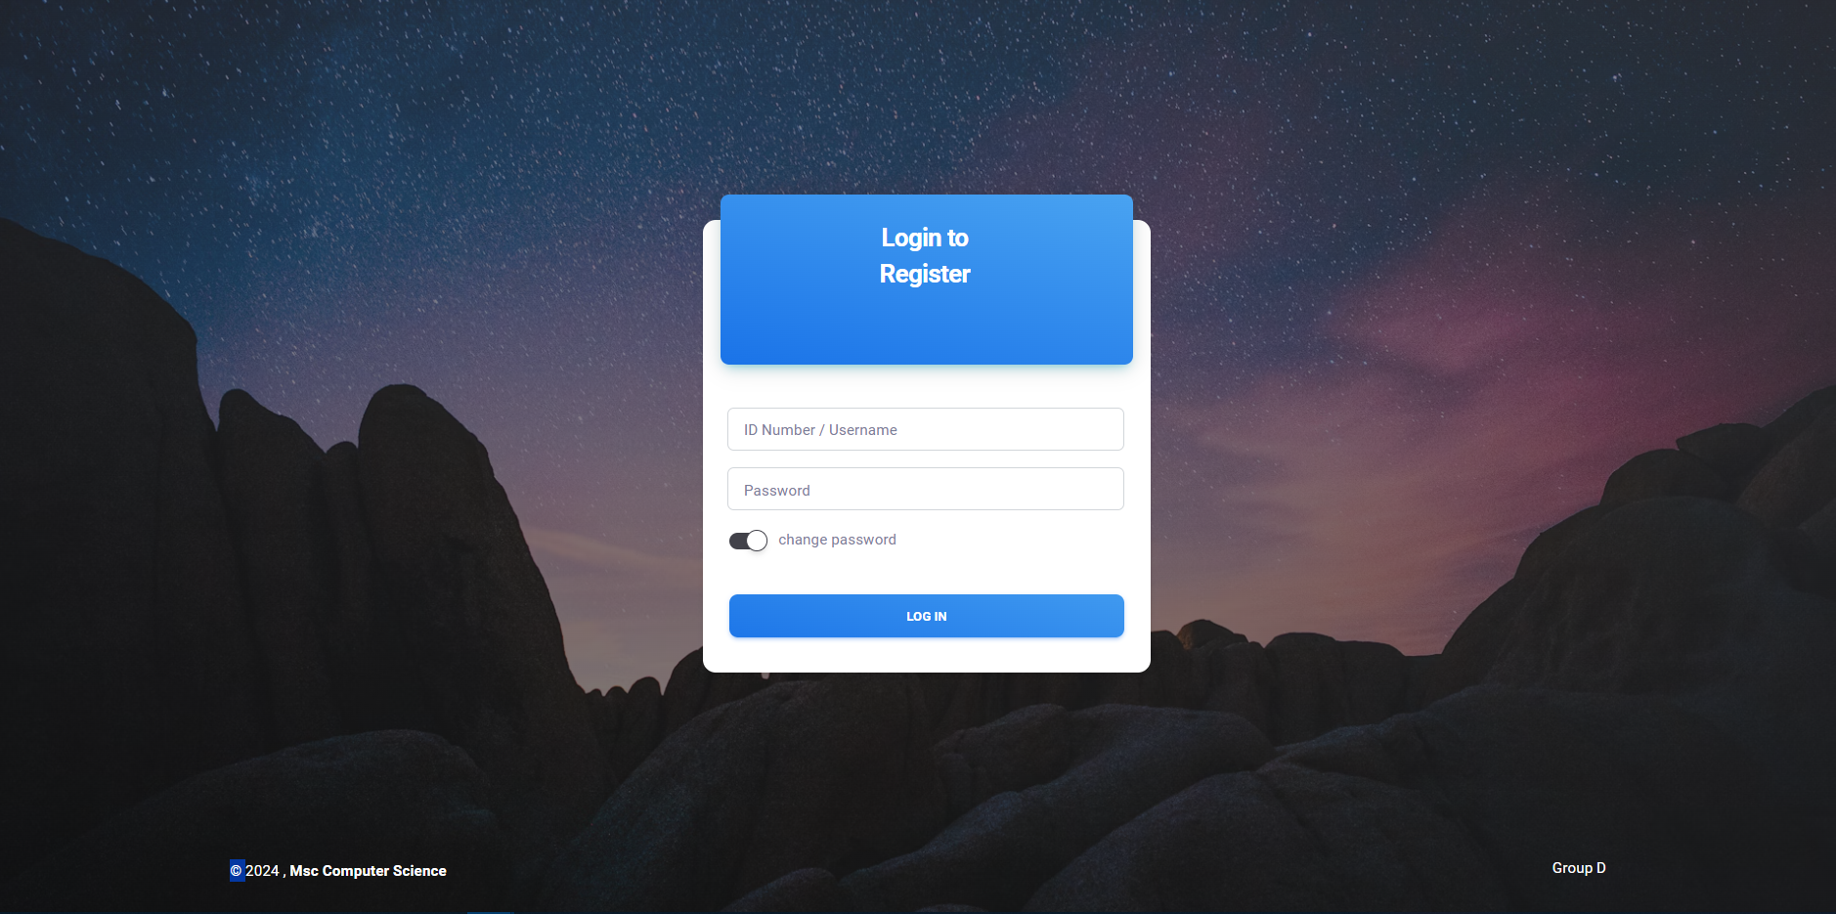
Enter Credentials:
Admin: Enter the admin username and password.
Student: Enter the student ID and password.
Click the Login button to access the dashboard.

Slide 7
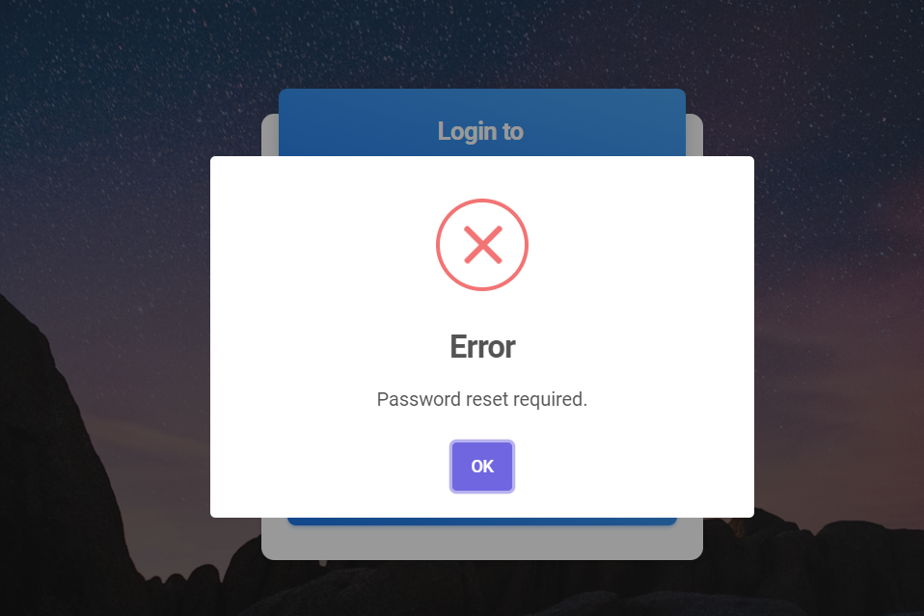
Enter Credentials:
First-Time Login:
If you are logging in for the first time, you may be prompted to change your password.

Slide 8
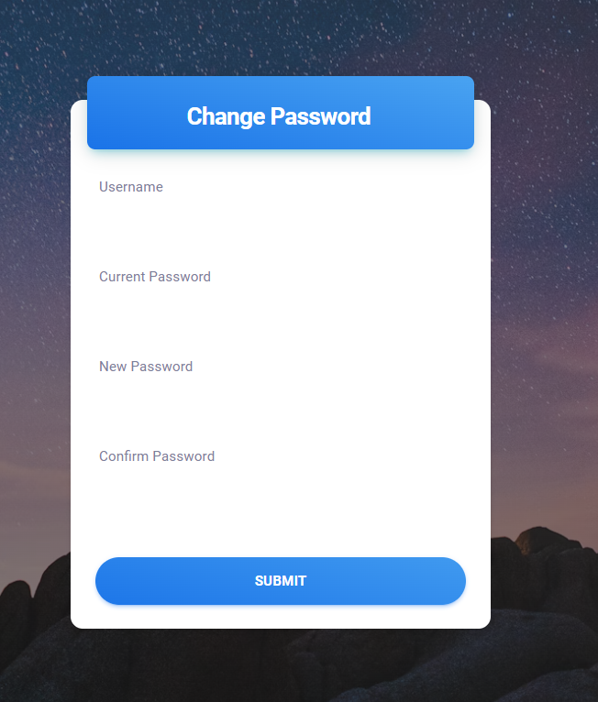
Enter Credentials:
Change Password:
Enter your ID Number or Username(for admin) in the user field and your Default Password.
Username for admin is ‘admin’ for the student the admin will provide the username.
Default password for Admin is ‘admin123’ and for student is ‘student123’

Slide 9
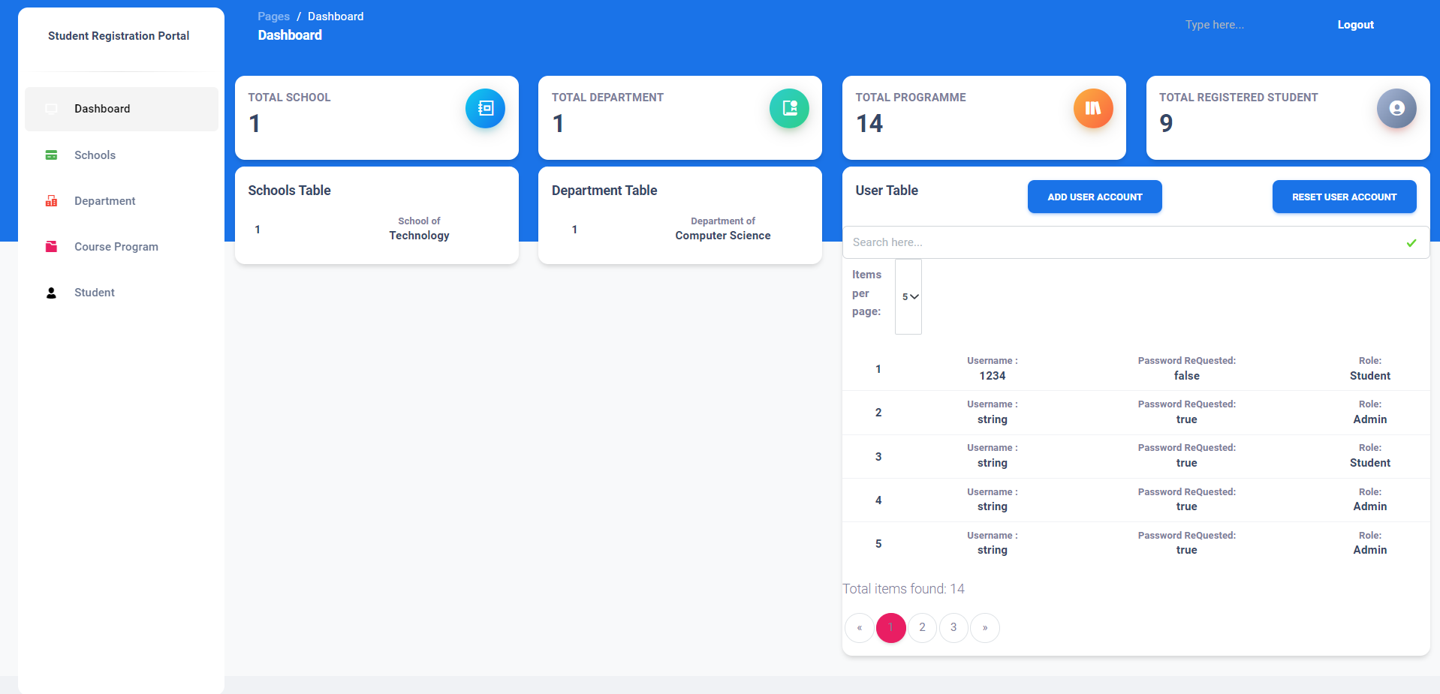
Dashboard Overview
Admin Dashboard: Displays options to manage school departments, student accounts, and course program
Student Dashboard: Shows options to register for courses, update personal details, and view registration status.

Slide 10
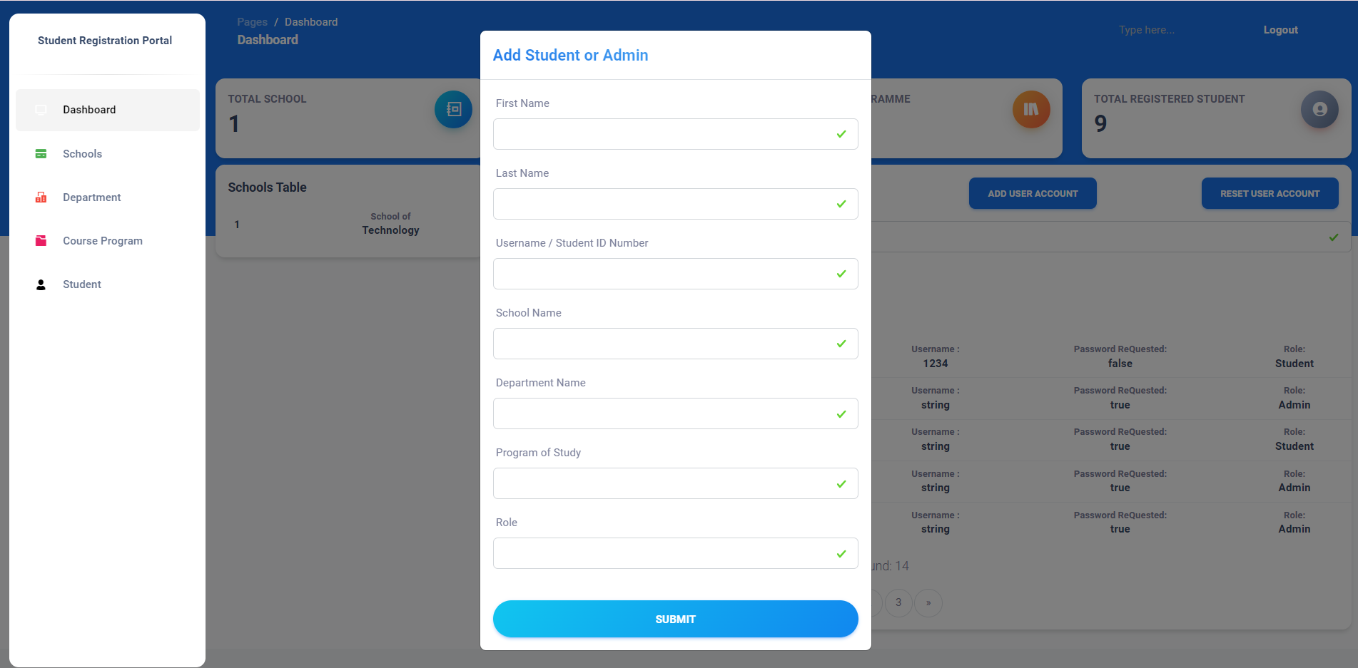
Admin Functions
Admin Dashboard: Admin Can CREATE a user account for student or administrative officials

Slide 11
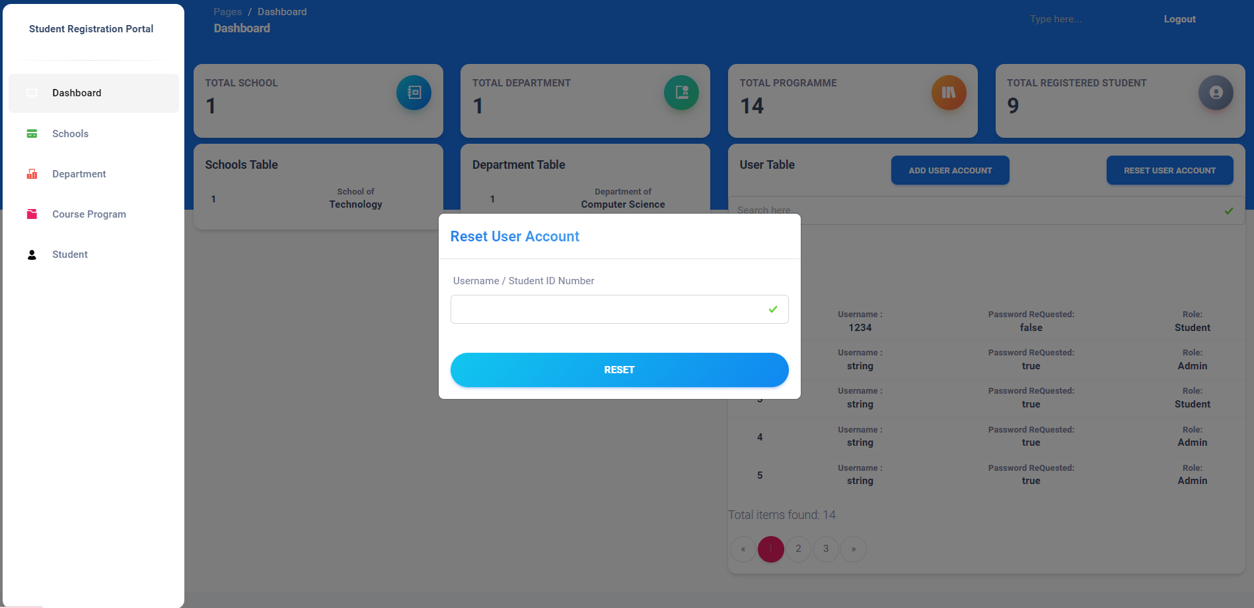
Admin Functions
Reset Password: Admin can reset user account if he/she forget the password

Slide 12
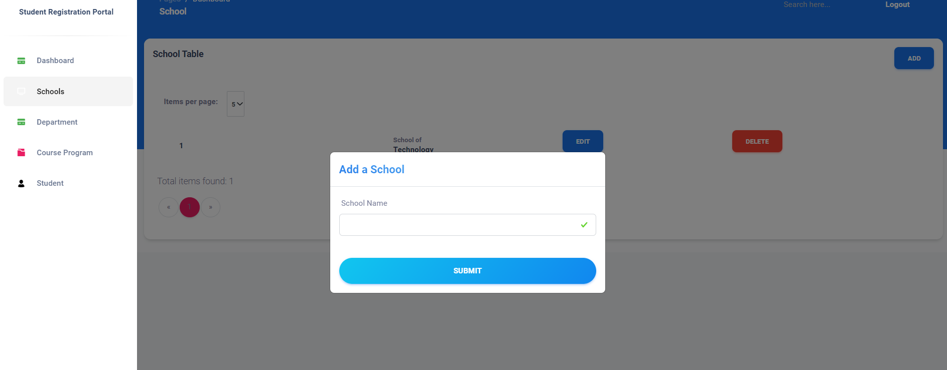
Admin Functions
Add School: Admin Can Add a School

Slide 13
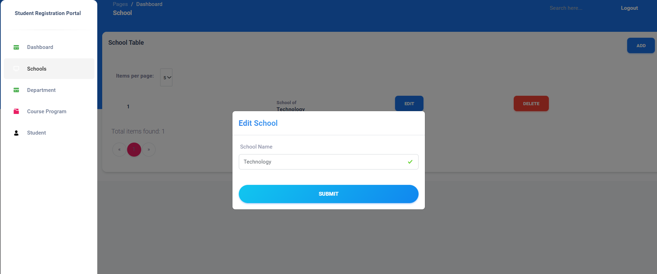
Admin Functions
Edit School Details : Admin can Modify School Name

Slide 14

Admin Functions
Add Department : Admin can ADD a Department

Slide 15
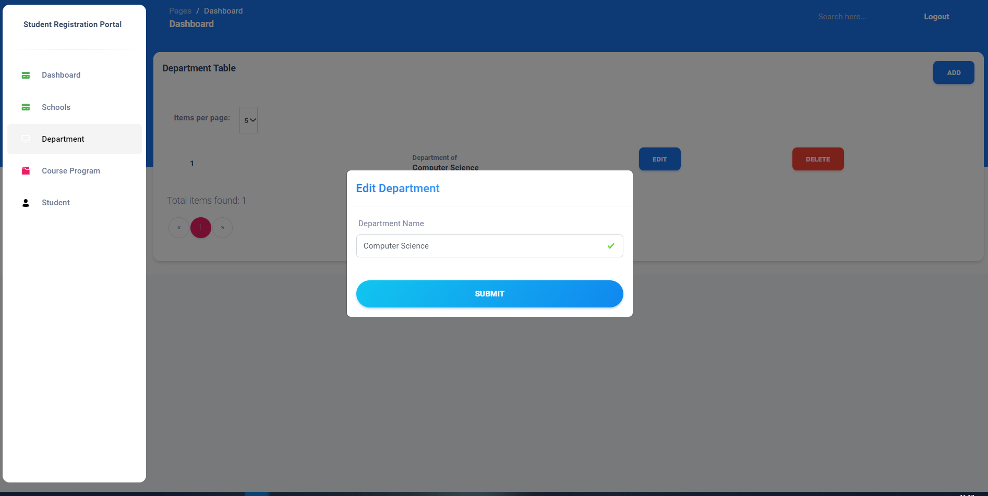
Admin Functions
Edit Department : Admin can MODIFY a Department

Slide 16
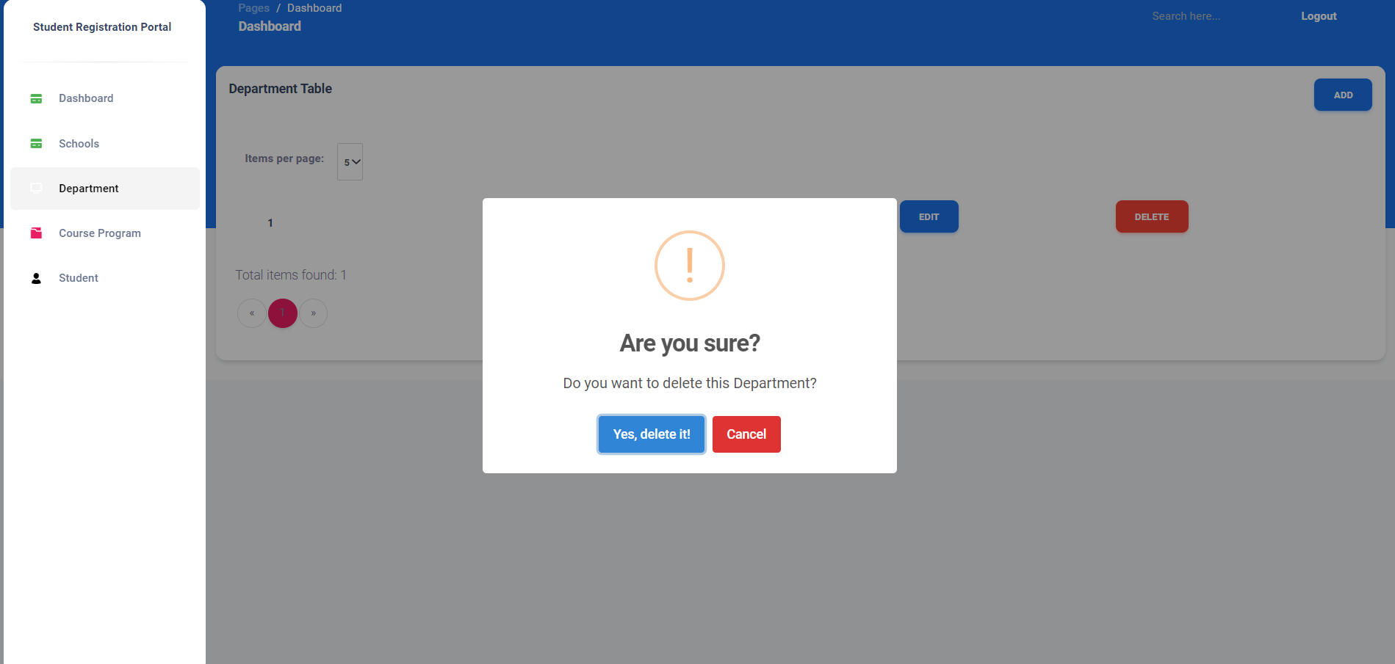
Admin Functions
Delete Department : Admin can DELETE a Department

Slide 17
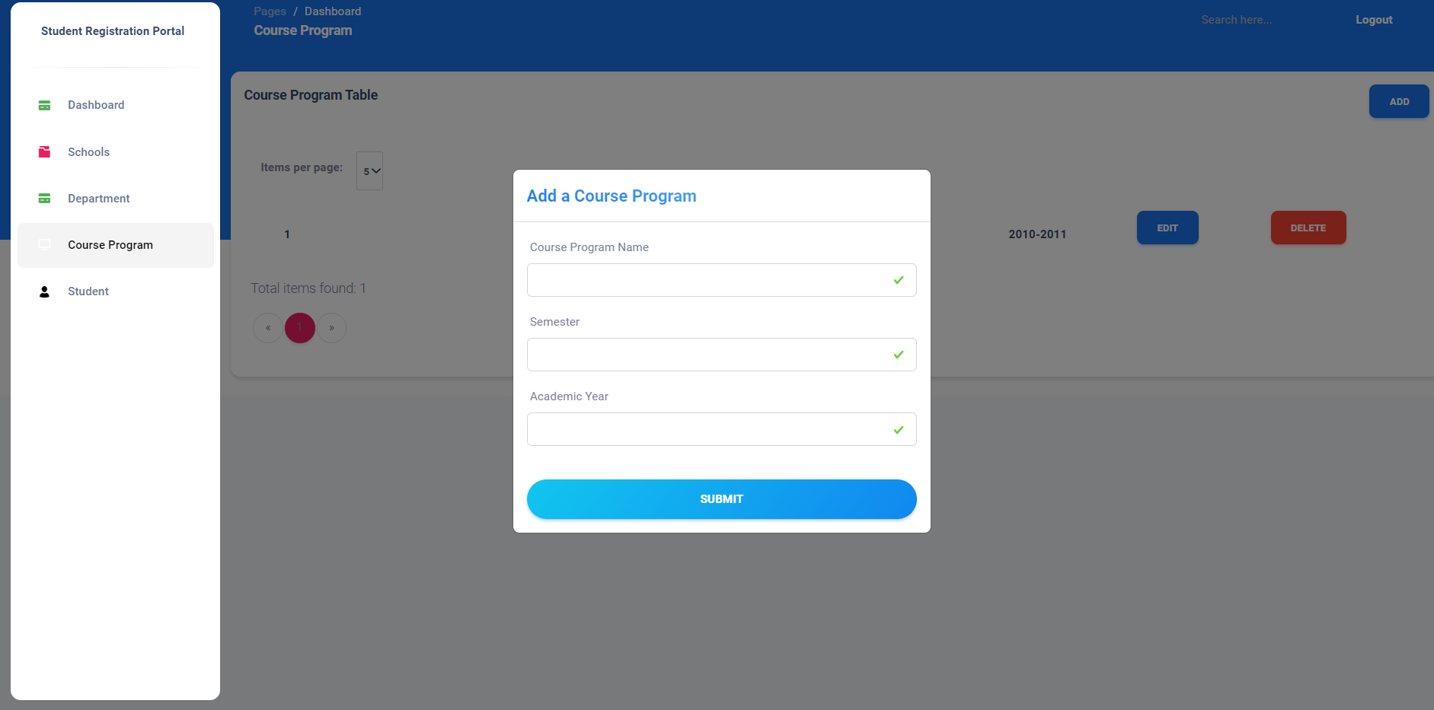
Admin Functions
Add Course Program : Admin can ADD a Course Program

Slide 18
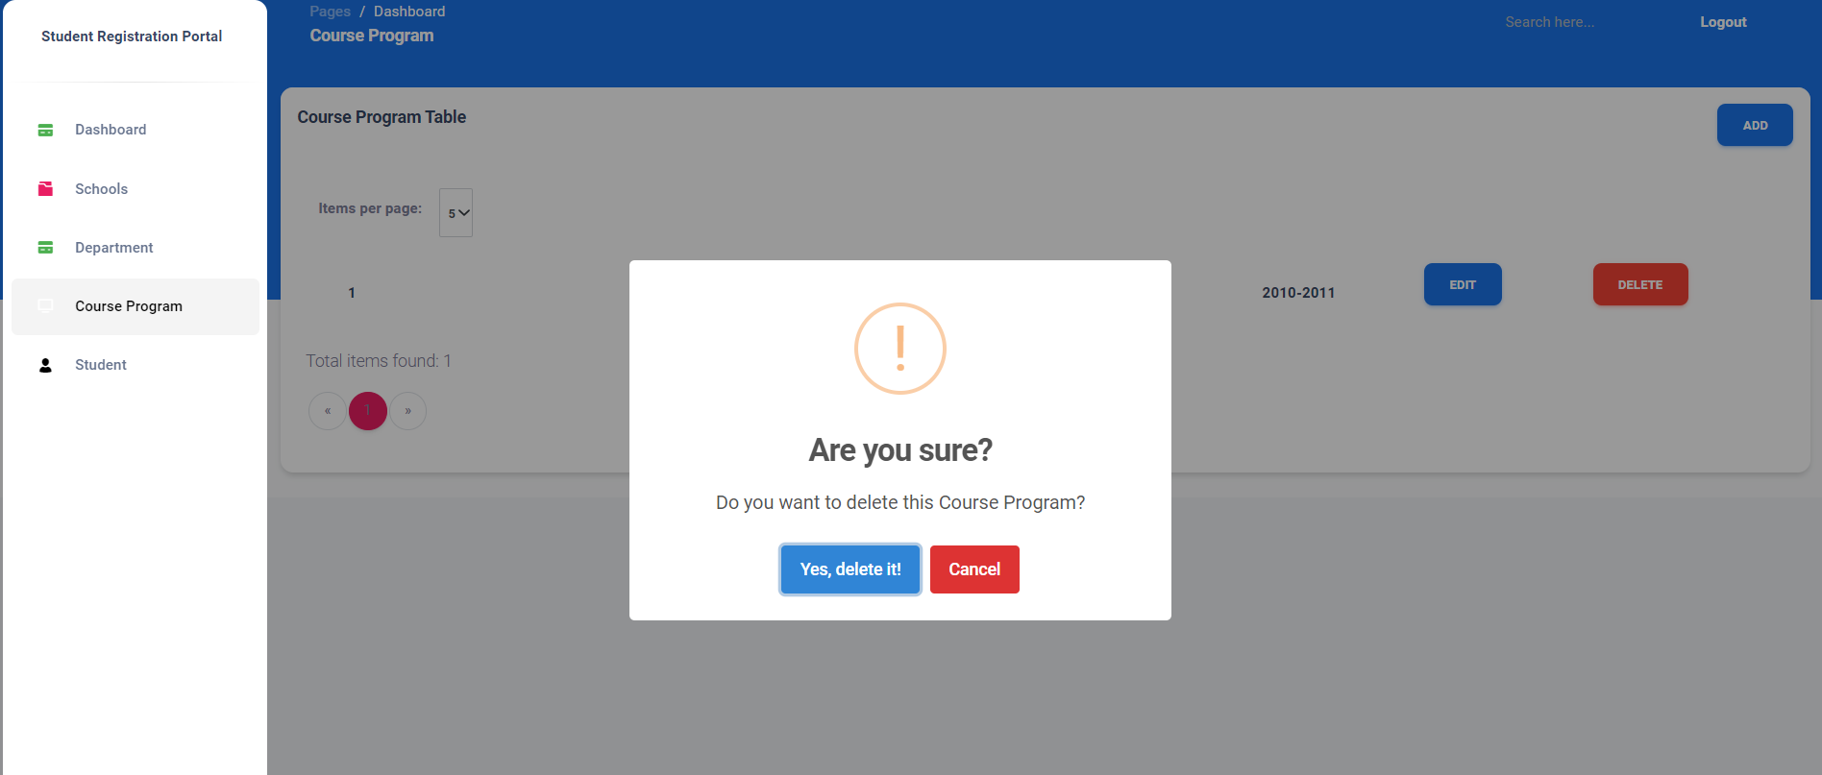
Admin Functions
Delete Course Program : Admin can DELETE a Course Program

Slide 19
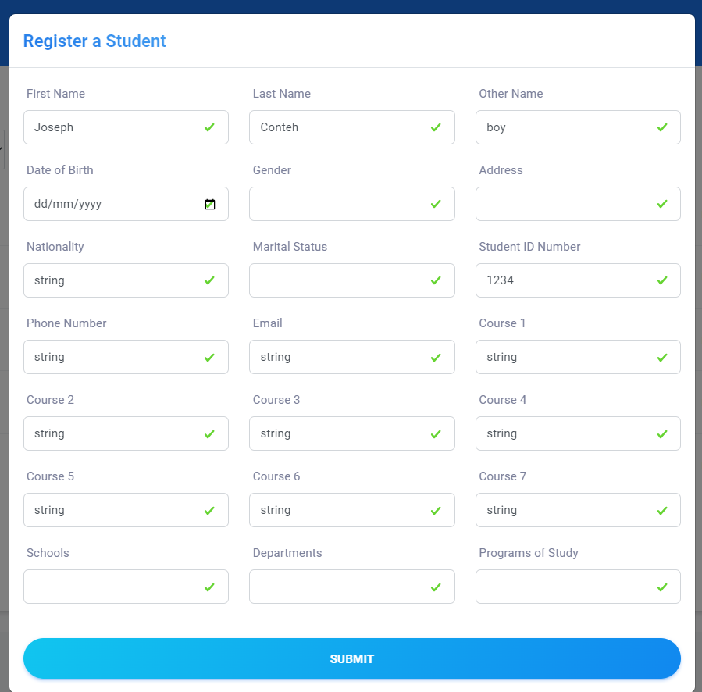
Student Functions
Student can Register Once

Slide 20
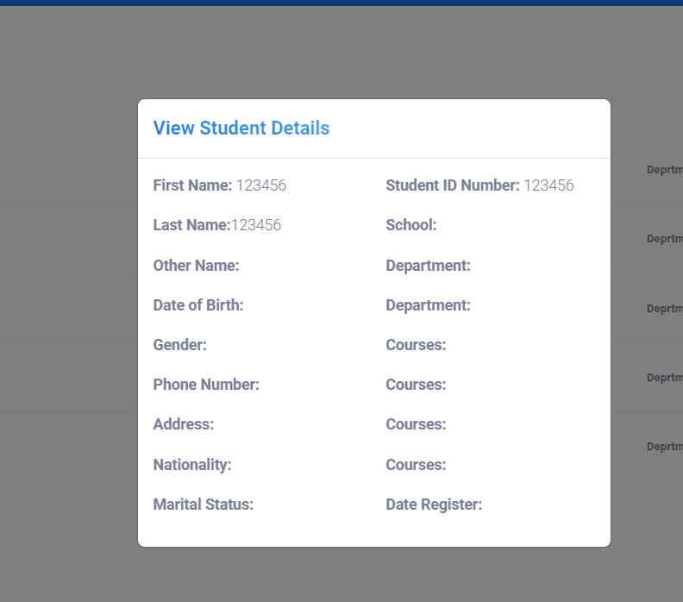
Student Functions
Student can View the Details

Slide 21
Troubleshooting & Contact Support
Login Issues: Verify your credentials and ensure your account is active.
Missing Fields: Check that all required fields are filled and try again.
Unable to Connect to the Database: Contact support if you encounter any technical issues.
Contact Support on Github:
http://github.com/zenofumi
http://github.com/bsaccoh
http://github.com/umarrkamara
Support Hours: Monday to Friday, 9 AM to 5 PM
Link to the source code on github:
https://github.com/Zenofume/GroupD_StudentRegistration_System

Slide 22

Thank You
Link to the source code on github
https://github.com/Zenofume/GroupD_StudentRegistration_System
Group G

